Slide 1
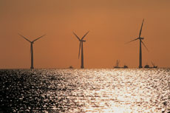
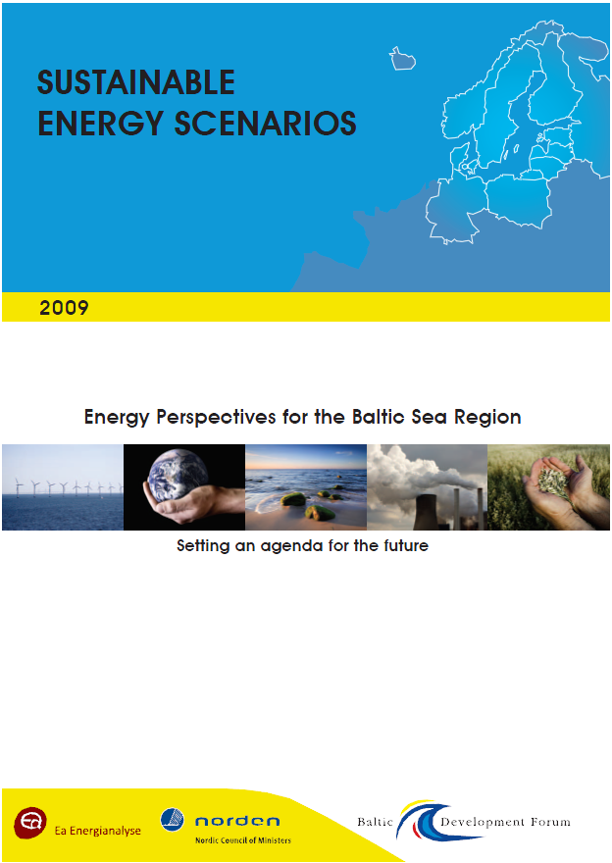
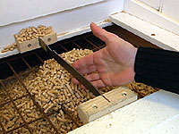
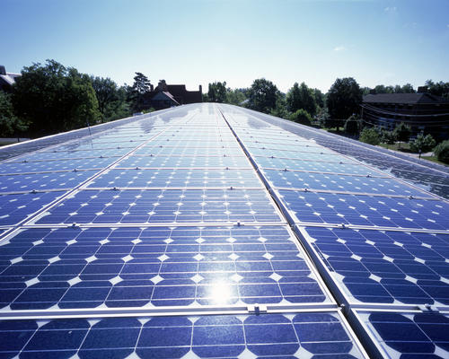
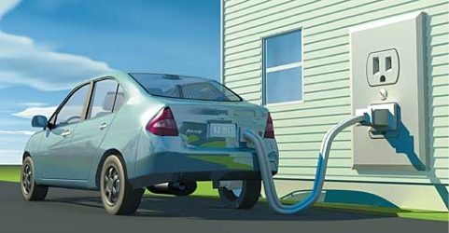
Study on ‘Enhanced regional energy cooperation in the Baltic Sea Region’
10th Inter-Parliamentary Meeting on Renewable Energy
16 April 2010
Anders Kofoed-Wiuff,
Ea Energy Analyses

Slide 2
Objectives
To promote a common energy agenda for the Baltic Sea Region through the involvement of key stakeholders
To provide a substantial basis for discussion of different energy scenarios for the region based on an analysis of energy data
Process
PHASE I
- Review of current energy situation
- Scenarios for 2030 – Big-tech and Small -tech
PHASE II
- Detailed scenarios of the electricity markets in the region 2010-2030
PHASE III
- Follow up analyses
- Case studies
May 2008
Feb 2009
Oct 2009

Slide 3
Developing scenarios
Fuel prices
Stakeholder dialogue
Energy demand
Baltic Sea Parliamentary Conference
Foreign Ministers
Basrec
Energy industry
Joint Platform Energy and Climate
UBC
EU
Efficiency measures
ScenarioAnalyses
Infrastructure
Results
Technology
data
Renewable resources
CO2-emissions
Storage CO2
250
Other energy
Electricity and district heat
200
Tranport
150
100
50
0
DG TREN
DG TREN
Ref_North
North
DG TREN
1990
2005
Scenario
2030

Slide 4
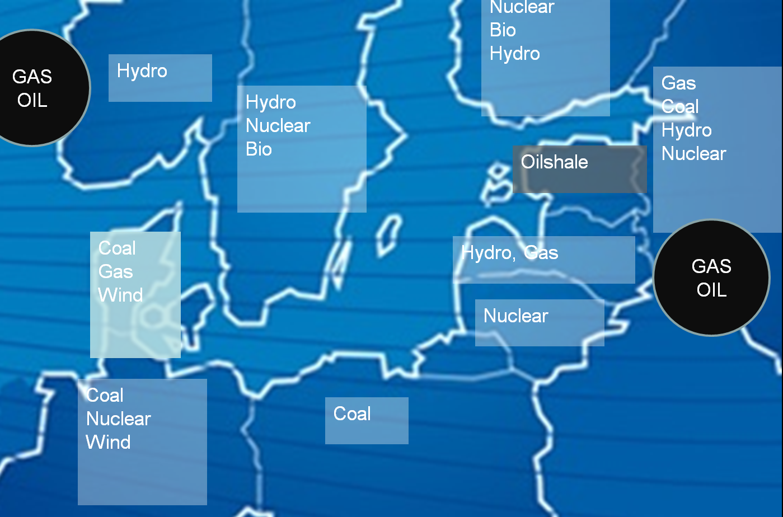
Phase I

Slide 5
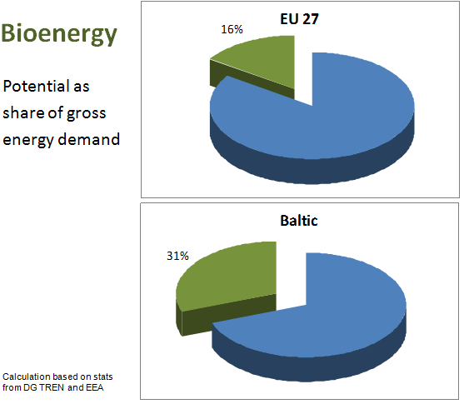

Slide 6
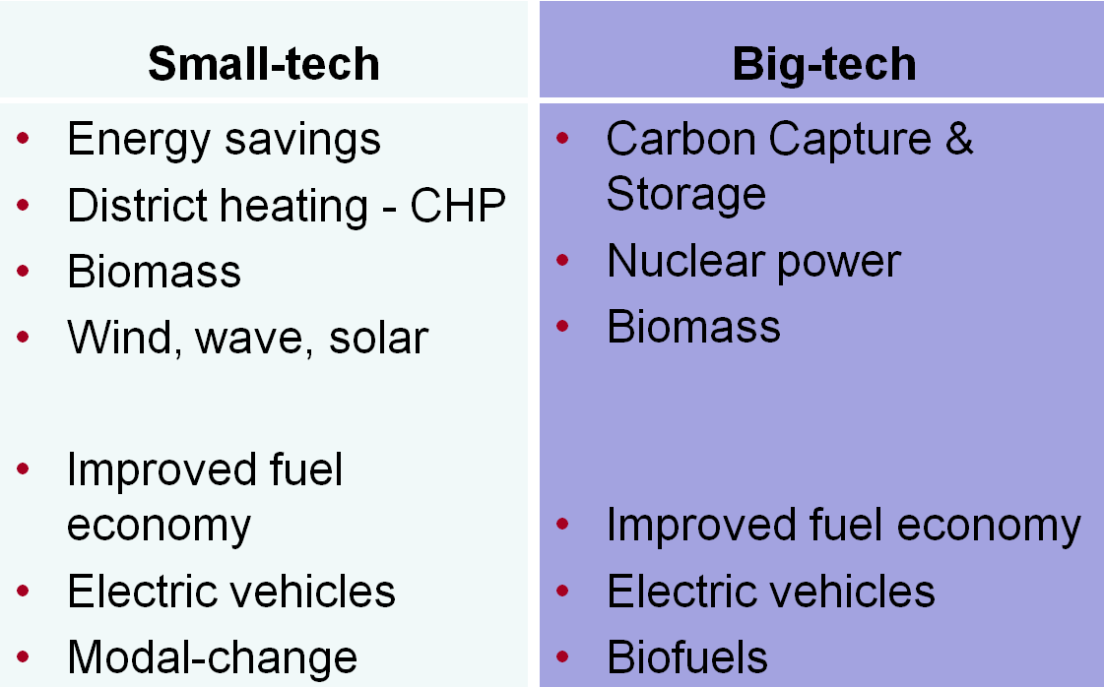
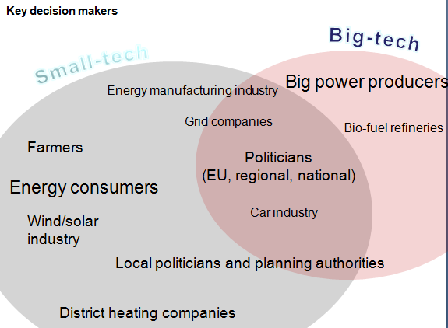
Two scenarios for 2030
Two targets
CO₂ -50 % (1990)
Oil -50 % (2005)

Slide 7
Energy consumption and CO2-emissions

Slide 8
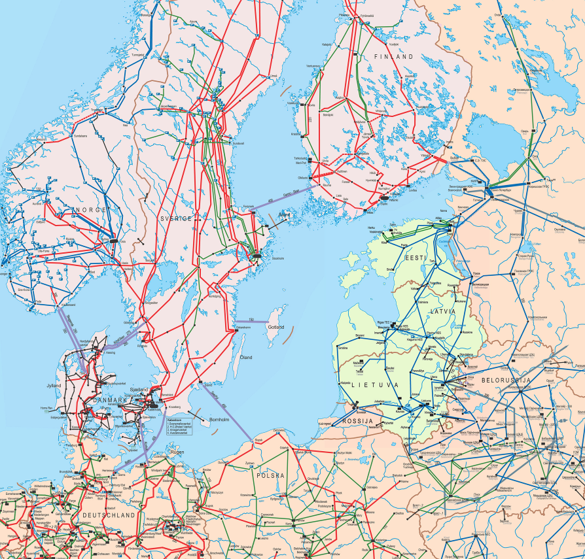
Phase II
Detailed analyses of the electricity markets 2010-2030
Targets
  2020: EU targets for CO2 and RE
  2030: 50 % CO2 reduction compared to 1990
Model decides new investments in generation capacity except nuclear and hydro power
Fuel prices according to International Energy Agency (WEO 2008) - 120 $/bbl in 2030
Baseline scenario and three variations
  regional targets for renewable energy
  Lower electricity demand
  More CO2-reduction in 2020
Including data for NW Russia

Slide 9
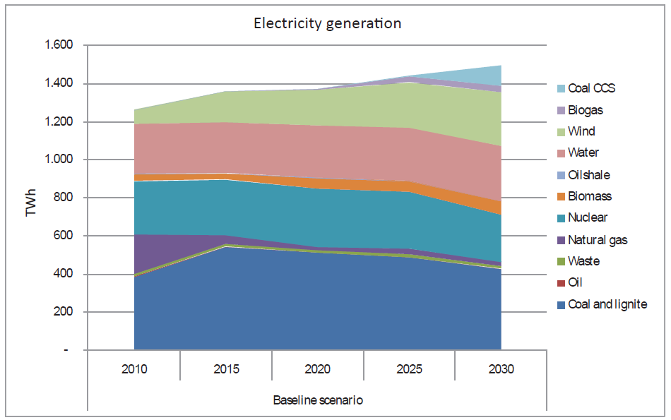
Generation outlook

Slide 10
Key findings
The targets can be met at reasonable costs
Potential for more efficient generation and consumption
Benefits of regional cooperation
  Interconnectors
  Electricity markets
  RE policies and projects
Stronger targets are possible
Hydro
Wind
Thermal

